Slide 1
Digital Marketing
Presented By
Tina Shrestha

Slide 2
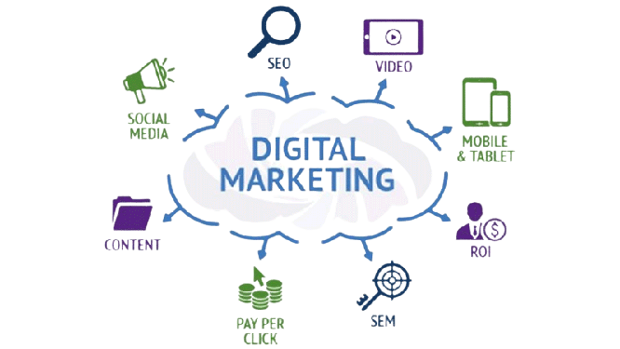
Content
Introduction of Digital Marketing
Various Module of Digital Marketing

Slide 3
Introduction of Digital Marketing
Digital marketing leverages online channels and technologies to engage a specific audience and achieve business objectives through the promotion of products, services, or brands.

Slide 4
Various Module of Digital Marketing
Content Marketing
Search Engine Optimization(SEO)
Search Engine Marketing
Social Media Marketing
Email Marketing
Web Analytics

Slide 5
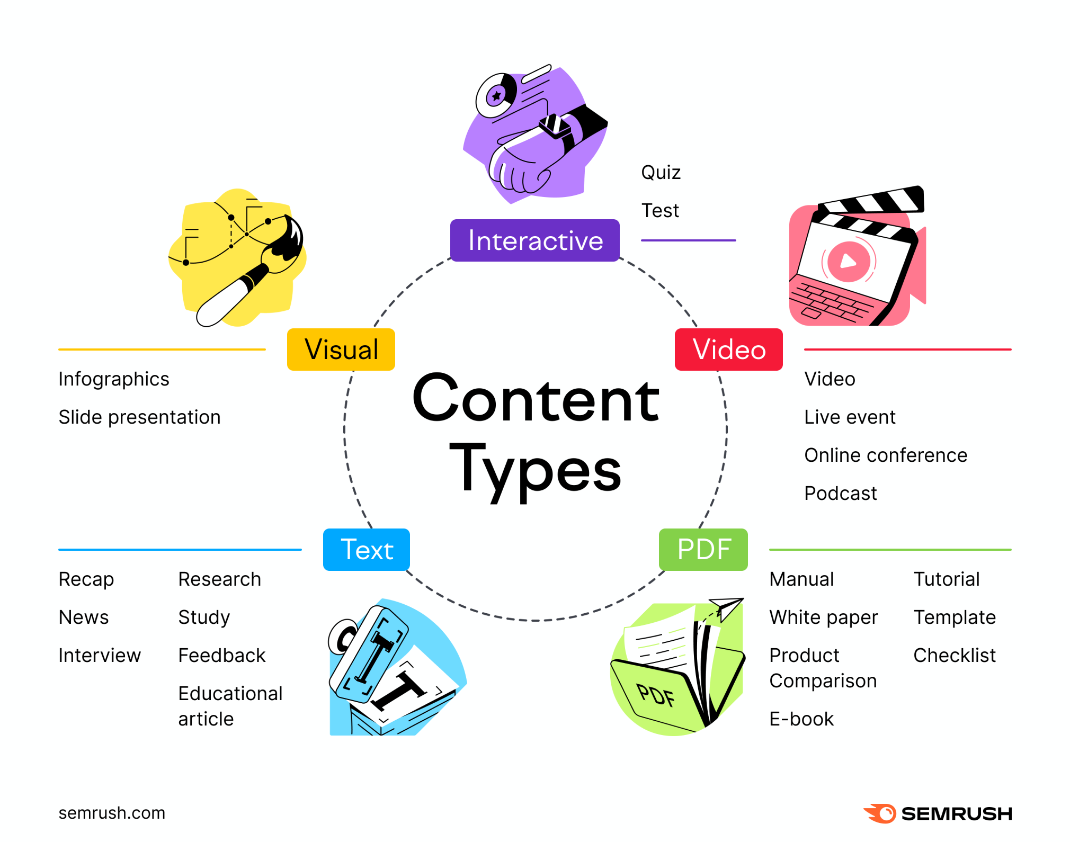
Content Marketing
Content marketing is the strategic creation and distribution of valuable content to engage and inform a target audience.

Slide 6
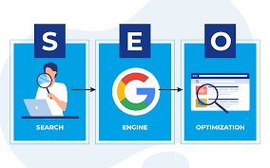
Search Engine Optimization(SEO)
SEO is the practice of optimizing web content and structure to improve a website's visibility in search engine results.

Slide 7

Search Engine Marketing
Search engine marketing (SEM) is a digital marketing strategy that involves paid advertising on search engines to increase a website's visibility and drive targeted traffic.

Slide 8
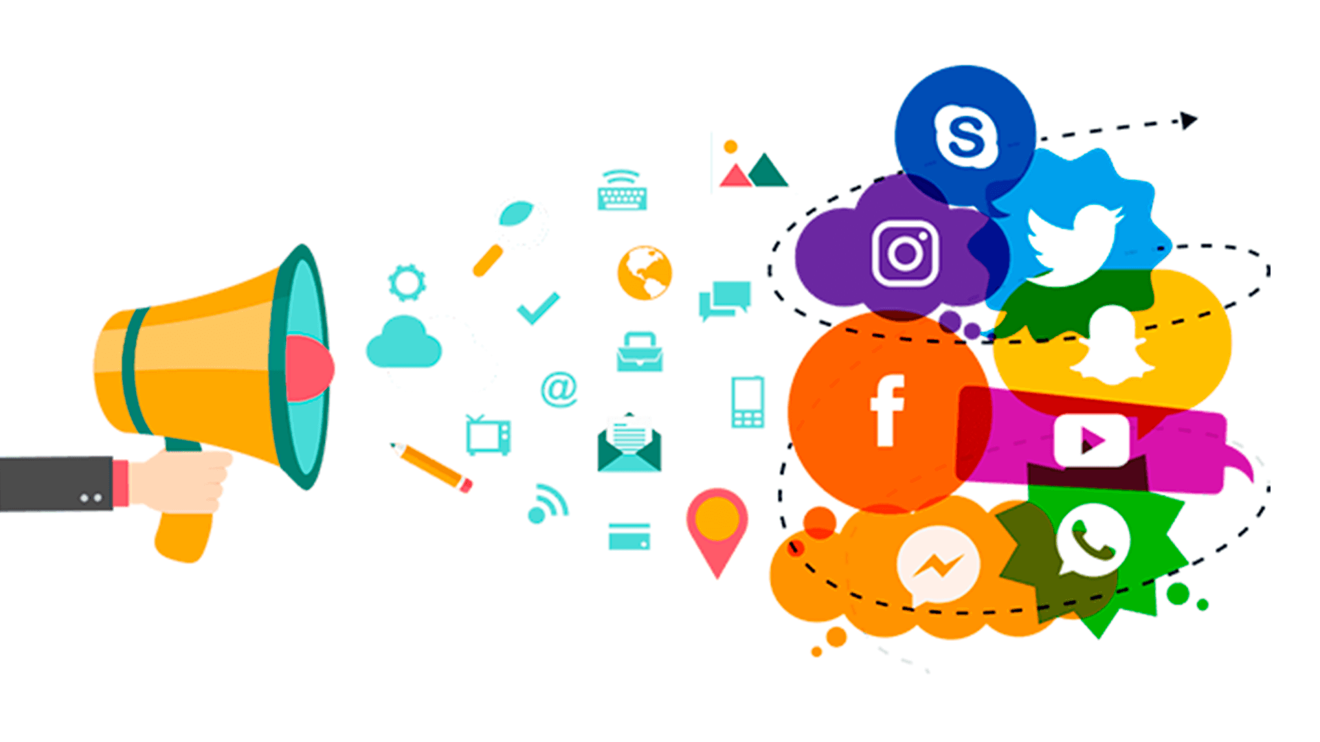
Social Media Marketing
Social media marketing is the use of social platforms to promote products, services, or brands, engage with audiences, and achieve marketing goals.

Slide 9
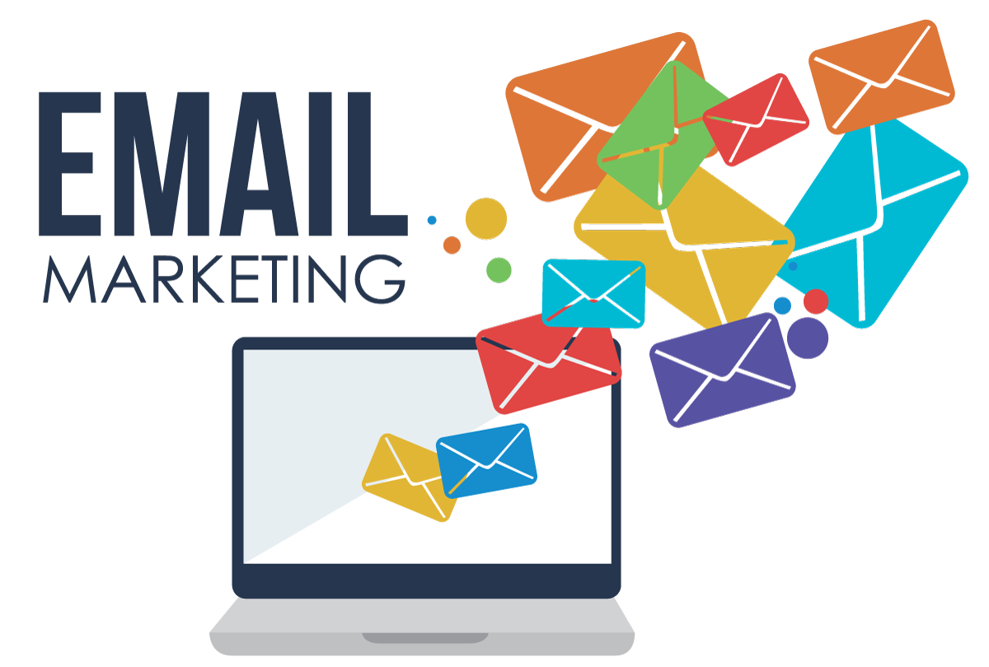
Email Marketing
Email marketing means the practice of sending targeted emails to a group of recipients to promote products, services, and events, among other things.

Slide 10
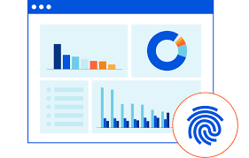
Web Analytics
Web analytics is the process of collecting, measuring, and analyzing data from a website or online platform to understand user behavior and optimize performance.

Slide 11


